Slide 1

Introduction to R
Caroline Hutchings
Norco College

Slide 2
Foundations of Version Control with Git and GitHub
Notes:
What Git and GitHub Are and Why They Matter for College Students

Slide 3
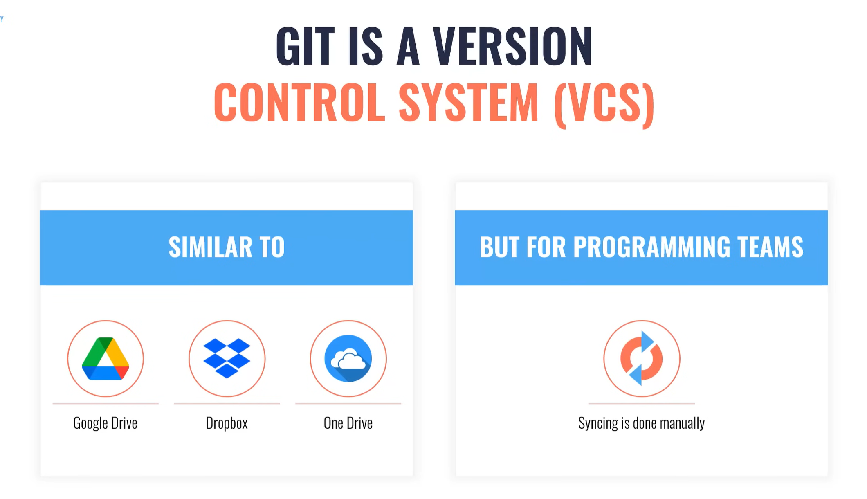
What is Git?
Git Version Control
Git tracks changes to files over time
Saves snapshots
Go back to earlier versions
Show differences between file versions
Git Command Line Interface (CLI)
Uses typed commands in terminal (Git Bash, Command Prompt)
git add, git commit, git push, git pull, etc.
Git Hub Desktop (GUI for Git)
Use Git without typing commands
Shows file changes automatically
Commit, push, pull
Git runs in the background
Notes:
Git is a version control system that runs on your computer and helps you track changes to files over time. Instead of saving multiple copies of a file like "final", "final_v2", or "final_really_final", Git creates a structured history of your work. Each saved point in that history is called a commit, which allows you to return to earlier versions, compare changes, or recover from mistakes. This is especially useful for college students who work on programming assignments, data analysis projects, lab reports, or collaborative group work. GitHub is a cloud-based platform that works with Git. While Git lives locally on your computer, GitHub stores copies of your repositories online. This provides automatic backup, makes it easy to access your work from different computers, and allows you to share projects with instructors or classmates. In many courses and professional environments, submitting assignments or collaborating through GitHub is a standard practice. For students, learning Git and GitHub builds important technical literacy skills. These tools are widely used in computer science, data science, statistics, engineering, and increasingly in non-technical fields such as social science research and digital humanities. Understanding the basics now helps students feel more confident working on longer projects, reduces the risk of losing work, and prepares them for internships or careers where version control is expected. In this presentation, Git and GitHub are taught using a graphical user interface (GUI), specifically GitHub Desktop. This approach removes the intimidation of command-line tools while still teaching the core concepts of version control. Students can focus on understanding how Git works conceptually—tracking changes, saving progress, and syncing work online—before later learning more advanced command-line techniques if needed.

Slide 4
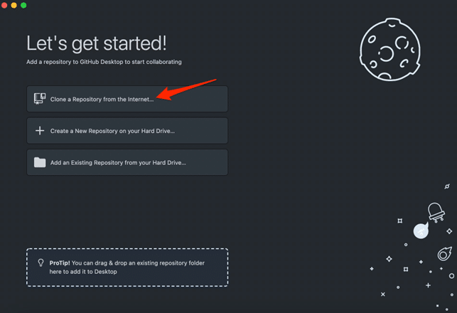
Download GitHub Desktop
Desktop.github.com/download
This Photo by Unknown Author is licensed under CC BY-NC-ND

Slide 5
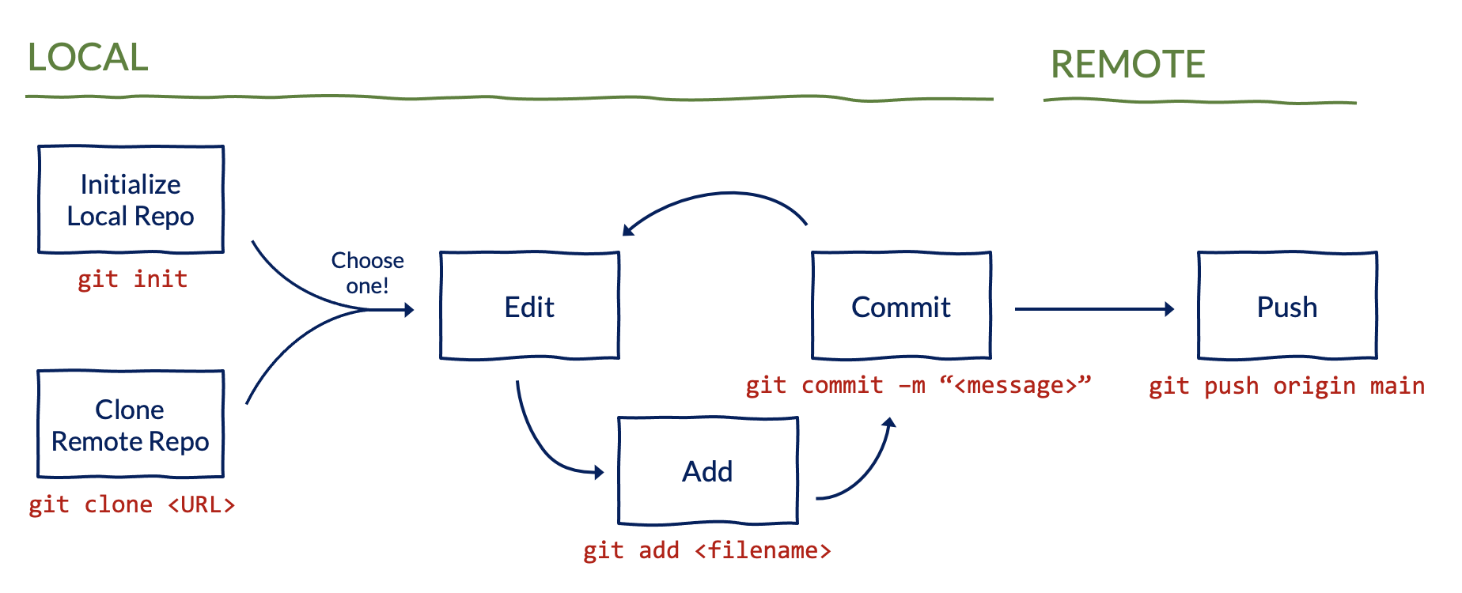
Basic Git Workflow
Start or Open a Project
Create repository
Add local repository
Clone repository
Create or Add Files
Add files to project folder
Track Changes
automatic
Save Your Work
Write a message
Commit to main
Upload to Git Hub
Push origin

Slide 6
Git vs GitHub
Git
GitHub
Git is a software
Git is CLI
GitHub Desktop is GUI for Git
Git is installed locally
Git is focused on version control
GitHub is a service
GitHub is a GUI (graphical user interface)
GitHub is hosted on the web
GitHub stores Git repository on web for easy access by entire team

Slide 7

Create a GitHub Account
https://github.com/
Sign up for an account
Fork on this repository
Clone the fork to GitHub Desktop
Work
Commit and Push

Slide 8
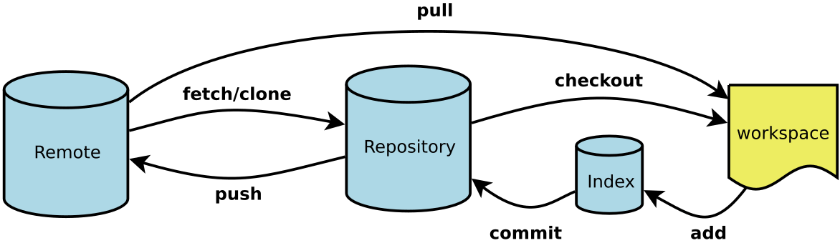
GitHub Workflow
Remote Repository (folder) on GitHub
Stores project online
Tracks changes
Allows collaboration
Pull changes from here
Push changes to here
Local Repository (folder)
Clone GitHub repository
Stores project locally
Commit local changes
Push changes from here
Pull changes to here
This Photo by Unknown Author is licensed under CC BY-SA-NC

Slide 9
What is R?
AI Definition:
R is a programming language and free software environment primarily used for statistical computing and graphics. It is widely utilized among statisticians, data scientists, and researchers for developing statistical software and data analysis.

Slide 10
Key Features of R:
Built-in Statistics Functions
Provides a variety of statistical tests, such as t-tests, ANOVA, etc.
Visualization Capabilities
Tools like ggplot2 facilitate high-quality visualizations.
Expanded Capabilities through Added Libraries
Thousands of packages are available on CRAN.
Integration with Other Tools, such as SQL
Connects with databases for efficient data manipulation.

Slide 11
RStudio Environment
Source Pane
Top left corner
Used for writing and editing R scripts and RMarkdown documents.
Console Pane
Bottom left corner
Executes R commands interactively.
Environment/History Pane
Top right corner
Environment Tab: Displays variables and objects in memory.
History Tab: Shows command history for the current session.

Slide 12
RStudio Environment (continued)
Files/Plots/Packages/Help/Viewer Pane
Bottom right corner
Files Tab: Navigate and manage files in the working directory.
Plots Tab: Displays visual outputs and allows interaction with plots.
Packages Tab: Lists installed packages; enables installation and loading.
Help Tab: Access to R documentation and function help.

Slide 13
Key Features of RMarkdown
Output Control: The use of chunk options allow for a cleaner, more focused presentation of content.
Multiple Output Formats: Create documents in formats such as HTML, PDF, Word, and PowerPoint.
Easy Text Formatting: Text can be formatted using Markdown Syntax.
Integration with R Packages: Supports R packages like ’ggplot2 for visualization and ‘dplyr’ for data manipulation.
Interactive Features: Interactive elements can be included in reports.
Notes:
RMarkdown is an authoring format that allows you to combine text, code, and output in a single document.

Slide 14
How to Use RMarkdown
Creating an RMarkdown Document:
In RStudio, navigate to File -> New File -> R Markdown… to create a new document.
Writing and Editing:
Write your text using Markdown syntax.
Insert R code chunks by navigating to +C and add an R chunk.
Structure your document with headers for organization.
Knit the Document:
Click the “Knit” button to generate the output in your desired format (HTML, PDF, Word, PowerPoint, etc.).

Slide 15
Example Header
--- title: "Your Presentation Title" author: "Your Name" date: "May 24, 2025" output: html_document: theme: "cosmo" toc: true toc_float: true ---

Slide 16
Vectors
Create a vector of numbers using assignment operator
nums <- c(1,2,3)
Create a vector of strings
week <- c('M', 'T', 'W', 'Th', 'F')
Create a vector with a range of numbers
range_numbers <- seq(1,10)
Length of vector
len_vector <- length(week)

Slide 17
Working with Vectors
Create a named vector
temps <- c('Mon'=88, 'Tue'=93, 'Wed'=95, 'Thu'=91, 'Fri'=86)
Retrieve names of vector
pull_names <- names(temps)
Add values to a vector
temps <- append(temps, c('Sa'=81, 'Su'=78))

Slide 18
Indexing
Identify item at specific index
item_one <- week[1]
All items except at specified index
not_two <- week[-2]
All items in vector of indexes
specific_items <- week[c(1,3,5)]

Slide 19
Working with Vector Operators
Relational Operators
temps == 81 temps > 88 temps != 81
Shorten the names of temps
names(temps) <- c('M', 'T', 'W', 'Th', 'F')
Select temperature of Friday
temps['F'] temps[5]

Slide 20
Dataframes
Create a dataframe from vectors
calendar_df <- data.frame(Month = months, NumDays = num_days, Season=seasons)
Add rows to a dataframe
calendar_df <- rbind(calendar_df, list('NewJan', 31, 'Bonus'), list('NewFeb', 29, 'Bonus'))
Add columns to a dataframe
calendar_df <- cbind(calendar_df, AvgTemp = avg_temp)

Slide 21
Logical Operators
Find Months with 30 days that are warmer than 70 degrees.
calendar_df$AvgTemp >=70 & calendar_df$NumDays==30
Find Months that have a temperature less than 70 degrees or are summer months.
calendar_df$AvgTemp <=70 | calendar_df$Season=='Su'

Slide 22
Logical Operators Application
Find proportion of months with 31 days that are above 70 degrees.
Find proportion of months that have less than 31 days or are above 70 degrees.

Slide 23
Tidyverse
Tidyverse is a set of packages that facilitate data science tasks in R. The main focus is on providing tools for data manipulation, exploration, and visualization.
Tidy Data: Where each variable is a column, each observation is a row, and each type of observational unit forms a table. This structure makes it easier to work with and visualize data.
Tibble: modern, user-friendly version of data frames in R that adheres to the principles of tidy data.
Modularity : Allowing users to load only the packages they need for specific tasks, making the workflow more efficient.

Slide 24
Core Components of Tidyverse
ggplot2:
Purpose: Data visualization
Features: Provides a coherent system for creating graphs
dplyr:
Purpose: Data manipulation
Functions: select, filter, etc. to manipulate tibbles.
tidyr:
Purpose: Data tidying
Functions: pivot_longer, pivot_wider, etc. help reshape data into a tidy format.

Slide 25
Components of Tidyverse
readr:
Purpose: Data import
Functions: read_csv, write_csv, read_delim, etc. imports data into a tibble by default.
readxl:
Purpose: Import excel data
Functions: read_excel imports data into a tibble by default.

Slide 26
Load Data Set
Load data using Kaggle API Token
Download data to computer and load data set
setwd("C:/working_directory/") #set to location of file tibble_df <- read_csv(“file_name.csv")

Slide 27
View Data in Spreadsheet Format
Features of the View(tibble_df) :
Column Headings : Each column in the data frame is represented as a header in the viewer.
Data Rows : Each row of data corresponds to an observation and is displayed in a horizontal format.
Scrolling : You can scroll through both the rows and columns if your data frame is larger than the viewing area.
Sorting : You can click on column headers to sort the data in ascending or descending order.
Filtering : Depending on the interface, you might be able to filter data directly through the viewer.

Slide 28
Missing Data
complete.cases(df)
is.na()
replace_na

Slide 29
Essential Tidyverse Functions in dplyr
mutate()
Adds or modifies columns in a data frame.
filter()
Subsets rows based on specified conditions.
select()
Chooses specific columns from a data frame.
summarize()
Generates summary statistics for variables.

Slide 30
Essential Functions in dplyr
arrange()
Sorts data by one or more columns.
group_by()
Groups data for analysis, facilitating operations like summarization.
piping (%>%)
Allows for chaining multiple dplyr functions together. Passes the output of one function directly to the next, enhancing readability and efficiency in data manipulation.

Slide 31
Comparison of Tibbles and Data Frames
Feature | Tibbles | Data Frames
Printing | Displays the first 10 rows, user-friendly | Prints all rows, which can be overwhelming
Column Types | Displays column types alongside data | Does not display column types clearly
Row Names | Does not support row names | Can have row names
Subsetting Behavior | Maintains tibble structure when subsetting | Converts to vector when single column is selected
Design Philosophy | Designed for use with the tidyverse | Traditional structure in base R
Handling of Data | Enforces stricter rules that avoid common errors | More flexible but can lead to confusion

